Slide 1


The Smoke and Fire Alerting System

Slide 2
Team Members
Shilpa Kuppili
Sri Sai Lalitha Mallika Yeturi
Priyadarshini Munigala
Sathwik Kuchana

Slide 3
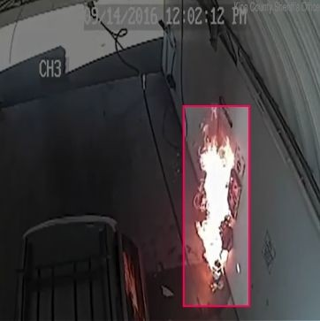
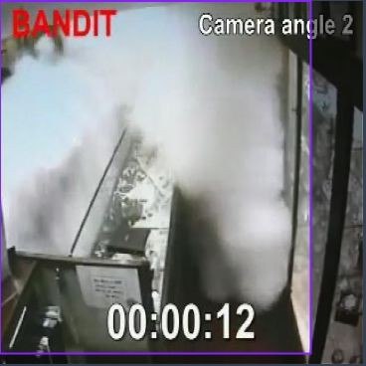

Dataset Collection

Slide 4
Custom Dataset
Total images = 979
Size = 608 x 608
Number of classes = 2
Training Data - 877
Validation Data-47
Test Data - 55

Slide 5
Dataset Processing
Leveraged Roboflow's API integration to streamline dataset acquisition and preprocessing.
Utilized Roboflow's annotation tools and data augmentation capabilities for improved model training.
Customized dataset access and version control through Roboflow's platform for enhanced project flexibility.
Ensured data security and access control by utilizing an API key for authentication purposes.

Slide 6
Model Training
Utilized YOLOv8 model for object detection training.
Customized the training task for object detection ('detect') to detect smoke and fire.
Trained the model on a custom dataset specifically curated for smoke and fire detection tasks.
Configured training parameters with 20 epochs and an image size of 800 pixels for optimal model learning.
Generated plots during training for visual analysis of key metrics like loss and accuracy, facilitating performance evaluation and adjustments.

Slide 7
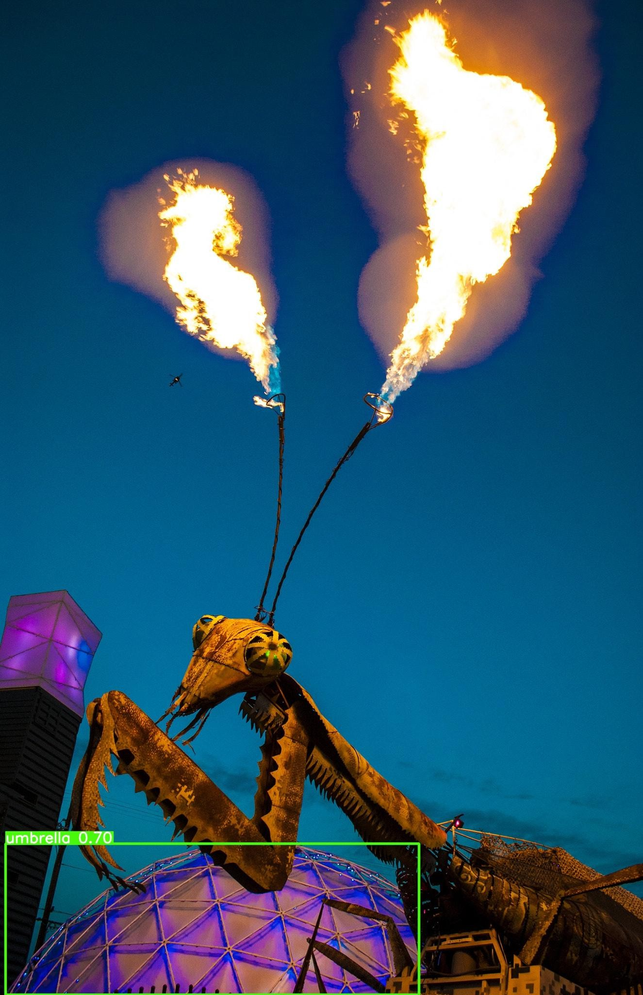

Results of Yolov8 Model
box loss : 0.9655
classification loss : 0.7124
Inference with pre-trained yolo model
Inference with yolo model which is trained on custom dataset

Slide 8
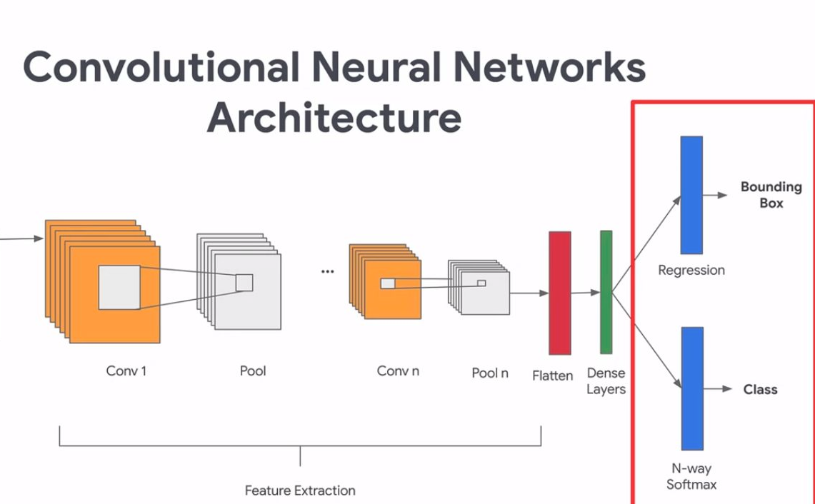
Custom Object Detection Model Architecture

Slide 9
Network Architecture
Feature extractor: these convolutional layers extract the features of the image.
classifier: This define the output layer that predicts among 2 categories (fire or smoke)
Bounding box regression: This defines the output layer that predicts 4 numeric values, which define the coordinates of the bounding box (xmin, ymin, xmax, ymax)
Final model: This combines the layers for feature extraction, classification and bounding box prediction.
Define and compile model: choose the optimizer and metrics, then compile the model.

Slide 10
Flow Chart of Steps
Data preprocessing
Data Visualization
Define the Network
Training &validatio n
Model Evaluation

Slide 11
Custom Model Summary
Custom Object Detection Model consists of the following layers:
(conv1): Conv2d(3, 32, kernel_size=(3, 3), stride=(1, 1), padding=(1, 1))
(conv2): Conv2d(32, 64, kernel_size=(3, 3), stride=(1, 1), padding=(1, 1))
(conv3): Conv2d(64, 128, kernel_size=(3, 3), stride=(1, 1), padding=(1, 1))
(conv4): Conv2d(128, 256, kernel_size=(3, 3), stride=(1, 1), padding=(1, 1))
(pool): MaxPool2d(kernel_size=2, stride=2, padding=0, dilation=1, ceil_mode=False) (fc1): Linear(in_features=200704, out_features=512, bias=True)
(fc2): Linear(in_features=512, out_features=3, bias=True) (fc3): Linear(in_features=512, out_features=4, bias=True)

Slide 12
Brief Overview of the Model
Convolutional layers
Conv1: Input: -
Processes input images with 3 channels, outputs 32 feature maps using 3x3 filters. Conv2: 32 filters with the size of 3 × 3 are applied to the 32 feature maps in.
Conv 3: Inputs 64 feature maps, outputs 128 feature maps using 3x3 filters. Conv4: 128 input feature maps with 256 output feature maps using 3x3 filters.
Each of the layers uses a stride of 1 and padding of 1 so that the size of the feature maps in both goes unaltered.
Pooling Layer:
Pool: Humans apply 2x2 max pooling with a stride of 2 to feature maps to make the sizes of the feature maps at the output half and reduce the spatial resolution of these maps, avoiding complex computations.
Fully Connected Layers:
FC 1: Fl Json feature maps and flats 200,704 inputs, acting as the first layer for integration of features into 512 outputs. FC 2: 512 connects to the features for detecting types of objects.
F3: Connects 512 features to 4 outputs for predicting the bounding box coordinates of objects.
That is, in this architecture, the model allows performing features' extraction and processing from images, classifying the objects, and predicting the location of the object within the image.

Slide 13
Results for Custom Model
Evaluation Metrics for Custom Object Detection Model:
An accuracy of 0.50 refer to the overall correctness of the detected objects.
Precision of 0.25 refers to the accuracy of the model in identifying objects as belonging to a specific class
A recall of 0.50 indicates the model's ability to find all relevant objects in an image.
A F1 score of 0.33 provides a balance between precision and recall
F1 Score | 0.3333
Precision | 0.2500
Recall | 0.5000
Accuracy | 0.5000

Slide 14
Summary of the Models
The evaluation metrics of Custom Model provide insights into different aspects of the model's performance in object detection tasks, including its ability to correctly classify objects, its sensitivity to detecting relevant objects, and the balance between precision and recall
.
The combination of architectural improvements, effective feature representation, direct optimization for object detection, and efficient inference contribute to the superior performance of YOLOv8 in object detection tasks.

Slide 15
Thank you

